Slide 1


Brain Tumor Detection (MACHINE LEARNING)
Prepared By:-
D19DCS155(Dhariya Parikh )
D19DCS157(Vatsal Shingala)
D19DCS159(Hardik Shiyani)
Semester:- 6
Branch:- CSE-2
Batch:- D
Guided By:-
Prof. Vidhi Pandya
Prof. Shraddha Vyas

Slide 2
CONTENT
Introduction
Statement Current System and its limitations(if applicable)
Proposed System and Scope of System.
Requirement Gathering Techniques Used
Hardware and Software Requirements
Project Definition and Planning
Snapshots
Demonstration
Limitations and Future Scope
Conclusion
References

Slide 3
INTRODUCTION
The key concept in this color-based segmentation algorithm with K-means is to convert a given gray-level MRI image into a color space image and then separate the position of tumor objects from other items of an MR image by using Kmeans cluster.
K-means clustering is suitable for biomedical image segmentation as the number of clusters is usually known for images of particular regions of the human anatomy
The experimental results will confirm that the proposed method helps pathologists distinguish exact tumor sizes and regions.

Slide 4
PROPOSED SYSTEM AND SCOPE OF SYSTEM
In Brain Tumour Detection we gone use color-based segmentation method that uses the K-means clustering technique to track tumor objects in magnetic resonance (MRI) brain images.
The method can successfully achieve segmentation for MR brain images to help pathologists distinguish exactly lesion size and region.
SCOPE:
It will make medical facility cheaper and easier for people who are suffering from such tumor as it is automated and faster to provide result.

Slide 5
Requirement Gathering Techniques Used
Observation-Made an active observation by reviewing the different research papers.
Focus Group-Reviewed our project idea by seeing demand and usage in medical field.

Slide 6


Tools and technology which we will use
Software :-
Python
Jupyter Notebook
Libraries :-
Open cv
matplotlib
SK
Numpy
Joblib

Slide 7
HARDWARE REQUIREMENTS
HARDWARE REQ. FOR DEVLOPING APPLICATION
I3 Processor or any higher processor
4GB RAM minimum
HARDWARE REQ FOR USING APPLICATION
I3 Processor Or any higher processor
4gb Ram

Slide 8
Project Definition and Planning
Project will be developed in three stages .
Initial stage –gathered information about our project and reviewed.
Initialization stage –implement the development.
Closer stage-Review our project and diagnosis the error in our project .
INTIAL STAGE
PROJECT IDEATION
INTITALIZATION STAGE
LEARNING ML TOOLS
CLOSER STAGE
TESTING THE PROJECT
DATA SET
ML TECHNIQUE TO IMPLEMENT
IMPLEMENTING ALGORITHMS ON DATA SET
RESEARCH ABOUT IDEA
ERROR SOLVED

Slide 9
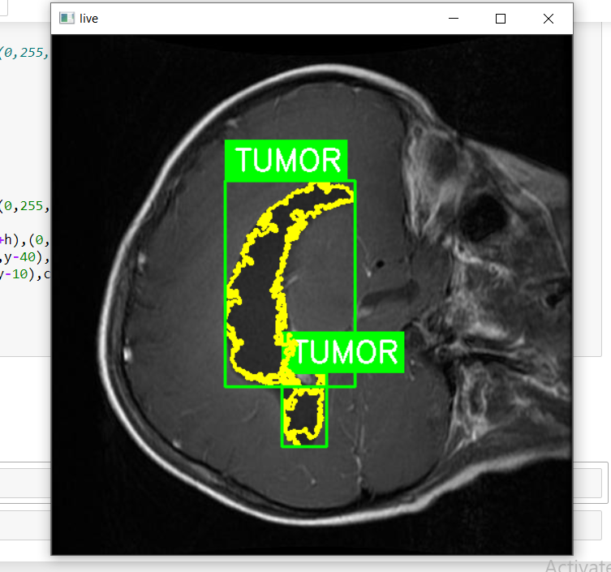
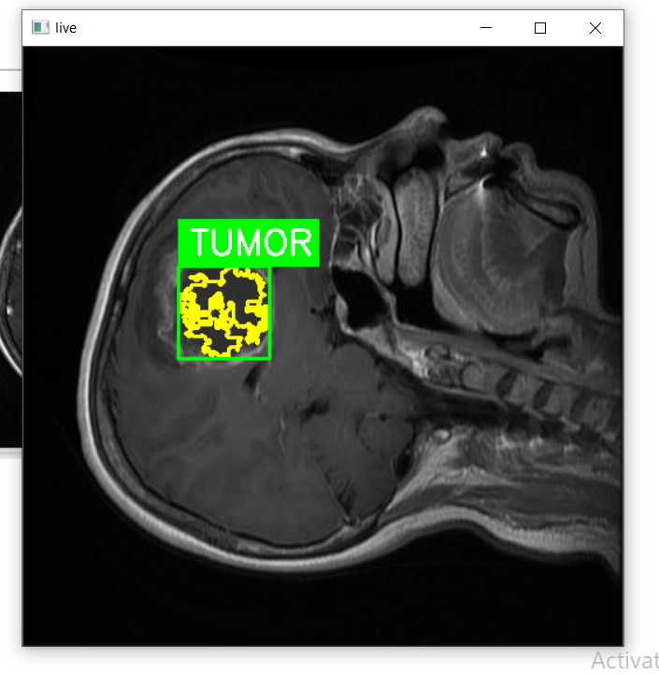
Snapshots

Slide 10
Future Scope:
GUI will be added.
We can implement user interface using tkinter which can make code more easy.
We can use more accurate algorithms in later versions.

Slide 11
LIMITATION AND FUTURE SCOPE
Limitations:-
GUI is not present .
Accuracy can be more improved
It cannot give exact length of tumor.

Slide 12
CONCLUSION
Here we conclude that we learn machine learning concepts while developing a color-based segmentation method based on K-means clustering for tracking tumor in the MRI brain image is proposed. The proposed method simply combines color translation, K-means clustering thus making it efficient and very easy to implement.

Slide 13
References
https://www.pyimagesearch.com/2015/02/02/just-open-sourced-personal-imutils-package-series-opencv-convenience-functions/
https://www.w3schools.com/python/numpy_intro.asp
https://docs.python.org/3/library/pickle.html
https://stackoverflow.com/questions/50473381/scikit-learns-labelbinarizer-vs-onehotencoder
https://www.tensorflow.org/api_docs/python/tf/keras/layers

Slide 14
THANK YOU

